Slide 1
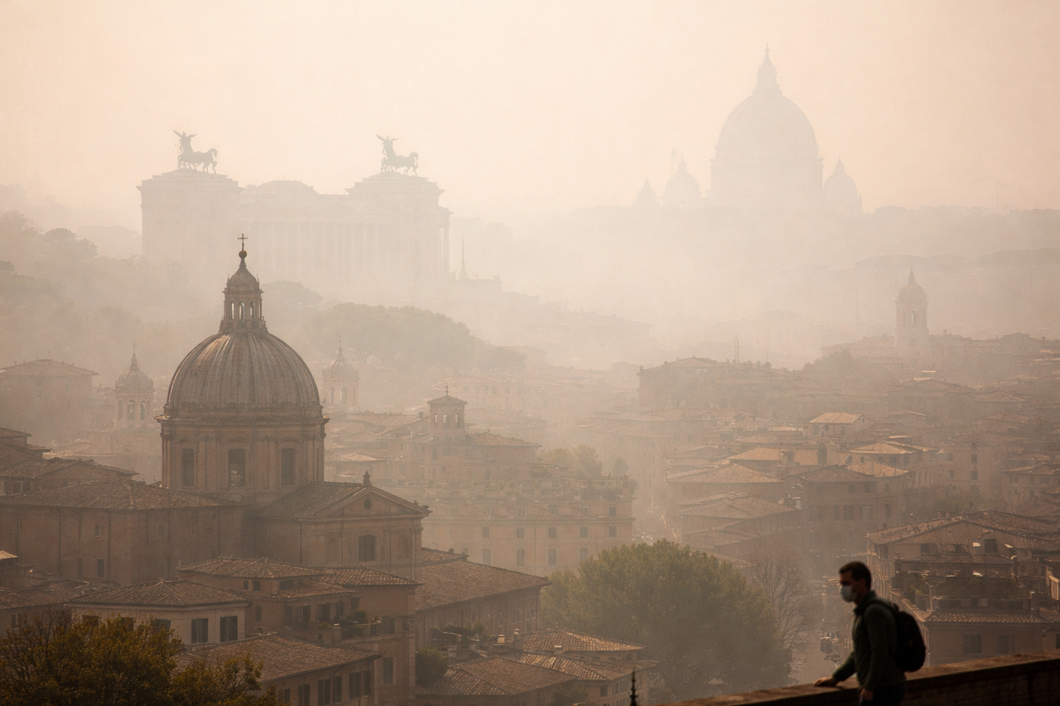

Air Quality Clustering
Grouping Air Quality Patterns Across 12 Months in an Italian City
Dr. Sebastian Diedrich - March 2026

Slide 2
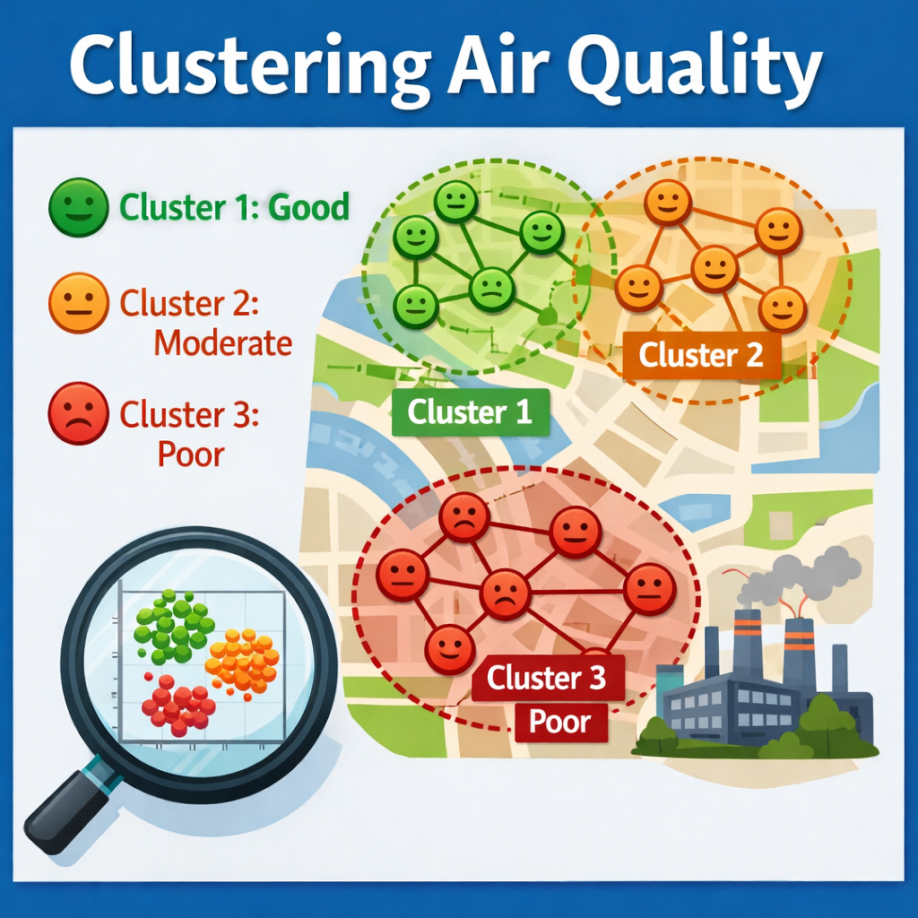
What is the Problem?
Air Quality and Health Issues
Air pollution is a growing global challenge with severe consequences for public health and economic sustainability.
According to the World Health Organization (WHO), air pollution is responsible for millions of premature deaths each year.
Analyzing and understanding daily air quality data can play a crucial role in addressing these challenges.
AI generated

Slide 3
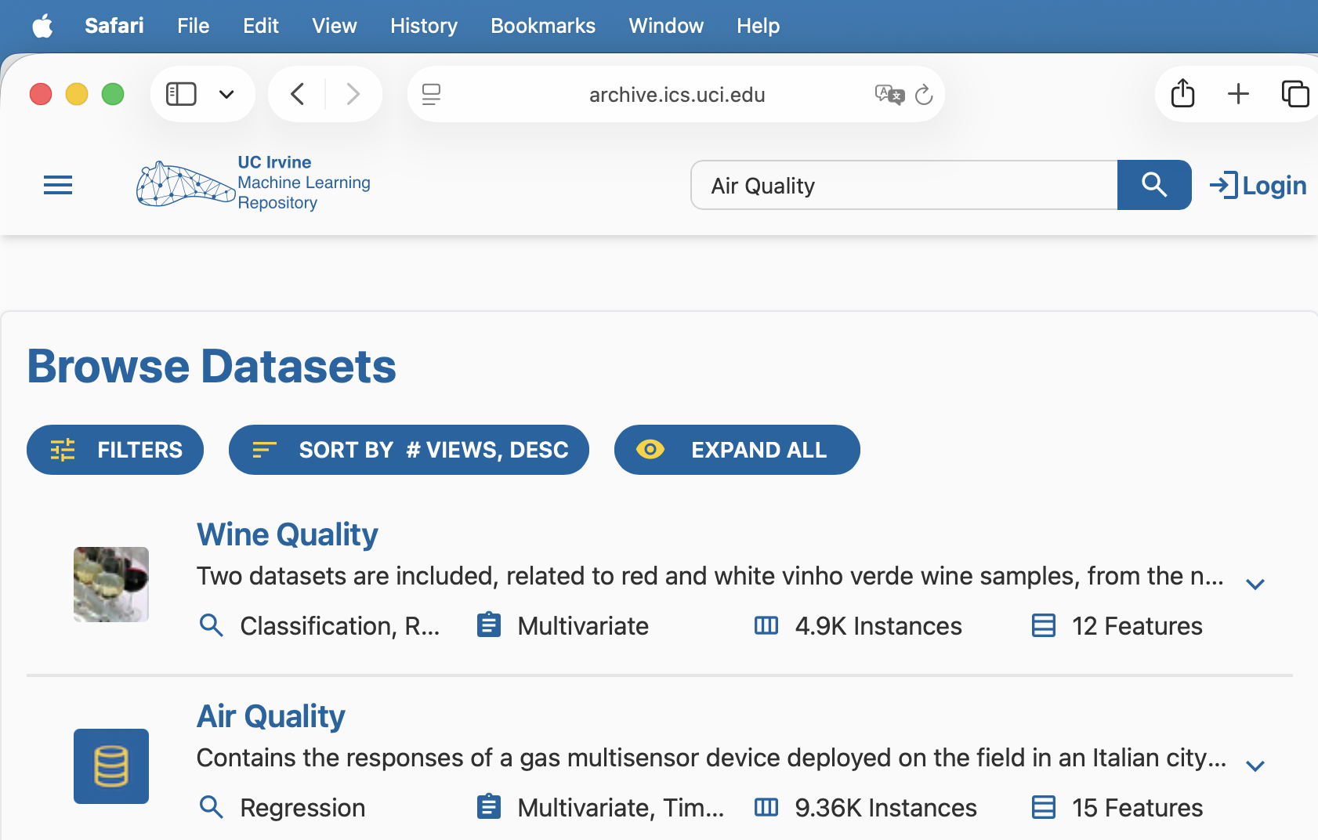
Which Data was used?
UC Irvine ML Repository
A data set of over 9,000 readings of Chemical Multisensor Devices - recorded from March 2004 to February 2005 (one year) in an Italian city
Features: pollutant levels, temperature, and humidity
Source: https://archive.ics.uci.edu/dataset/360/air+quality Vito, S. (2008)

Slide 4
What is the Goal?
Air Quality Clustering
Gaining insights, so actionable recommendations (low, moderate, high pollution level) can be provided to the public to reduce exposure to harmful pollutants.
For example, guidance can be given on when to avoid leaving the house or which times of day are safest for outdoor physical activities such as exercise.
In addition, weather forecasts combined with air quality predictions can be used proactively by authorities to manage traffic and industrial activity before pollution levels rise too high.
This preventive approach can help protect public health while reducing long-term healthcare costs.

Slide 5
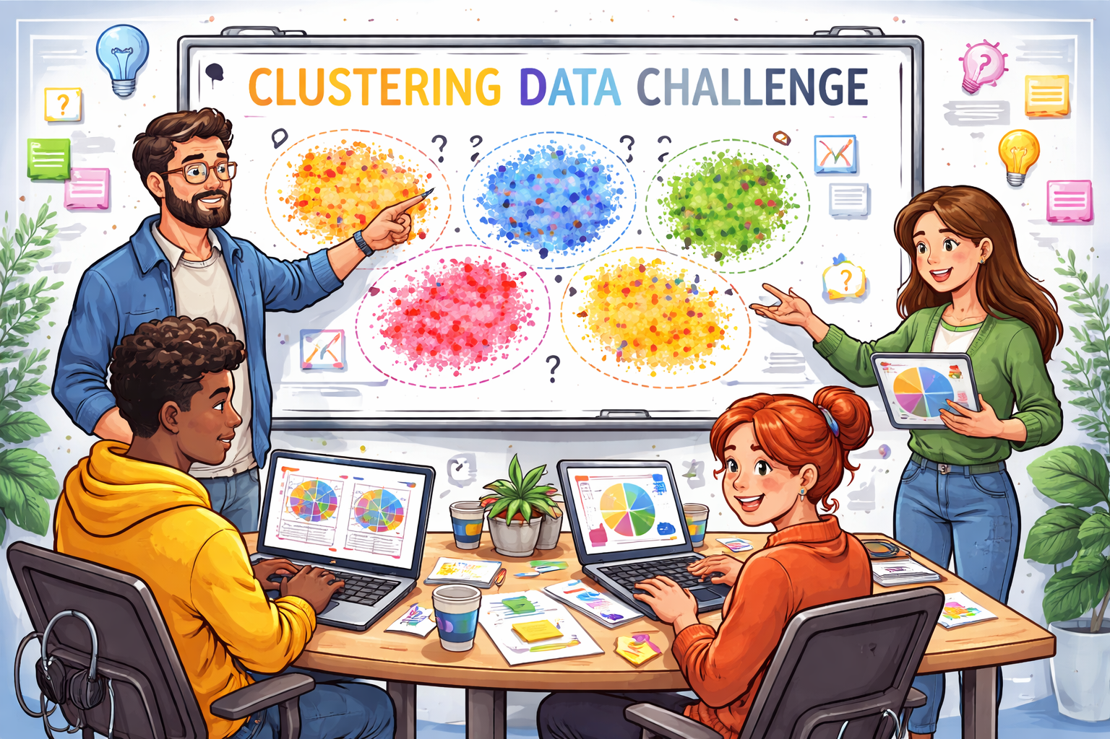
What is the Challenge?
Risks
What is a low, moderate or high pollution level?
Dataset is only from one location - no comparison between different locations possible.
Data is approx. 20 years old - still worth to cluster it?
How can the results be published to the public?
AI generated

Slide 6
What is the Challenge?
Strategy
What is a low, moderate or high pollution level? -> Adding WHO thresholds for air pollution can help to get a meaningful cluster
Dataset is only from one location - no comparison between different locations possible. -> Gaining insights into how pollution levels may vary by time of day and across seasons at this location
Data is approx. 20 years old - still worth to cluster it? -> Dataset has over 9,000 measurement points. Good for a proof-of concept!
How can the results be published to the public? -> Providing an API or even better a ChatBot with live pollution data that can answer questions like: “What is a good time and location for a run?”
AI generated

Slide 7
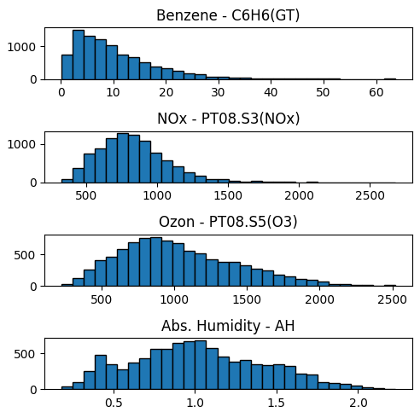
Data Quality
Cleaning and handling errors
The data could be cleaned without losing data via interpolation
Only one pollutant (Non Metanic Hydro Carbons) had to be excluded because of 90% error readings
The dataset was also augmented with features derived from the World Health Organization (WHO) toxin threshold guidelines
Additional features were introduced to examine potential seasonal and daily patterns associated with fluctuations in toxin concentrations, like Month or HourOfDay
Distribution after cleaning and interpolation

Slide 8
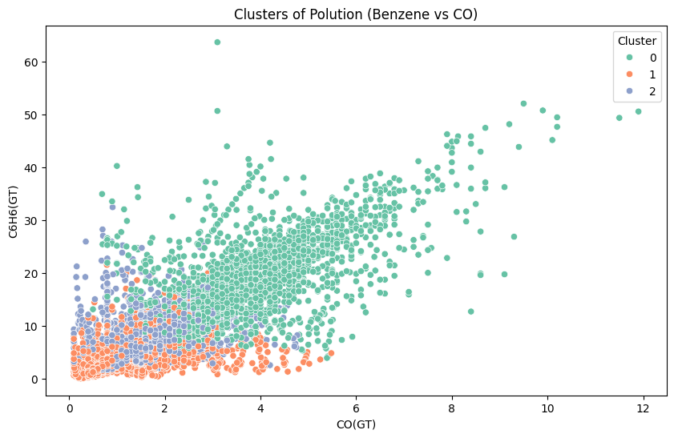
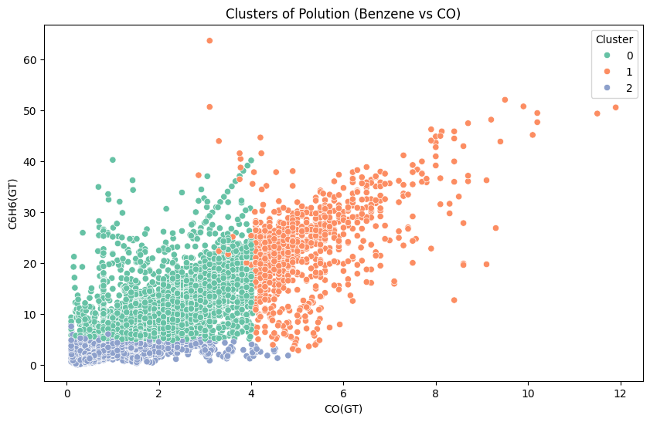
Modeling
Unsupervised: Clustering
Two clustering methods were applied: K-Means and DBSCAN.
K-Means was performed on both the original dataset and the dataset augmented with additional WHO thresholds.
However, the Silhouette Score was relatively low, indicating that the data is not well-suited for clearly defined clustering.
a) K-Means: ’Raw’ data from UCI
b) K-Means: Threshold features included

Slide 9
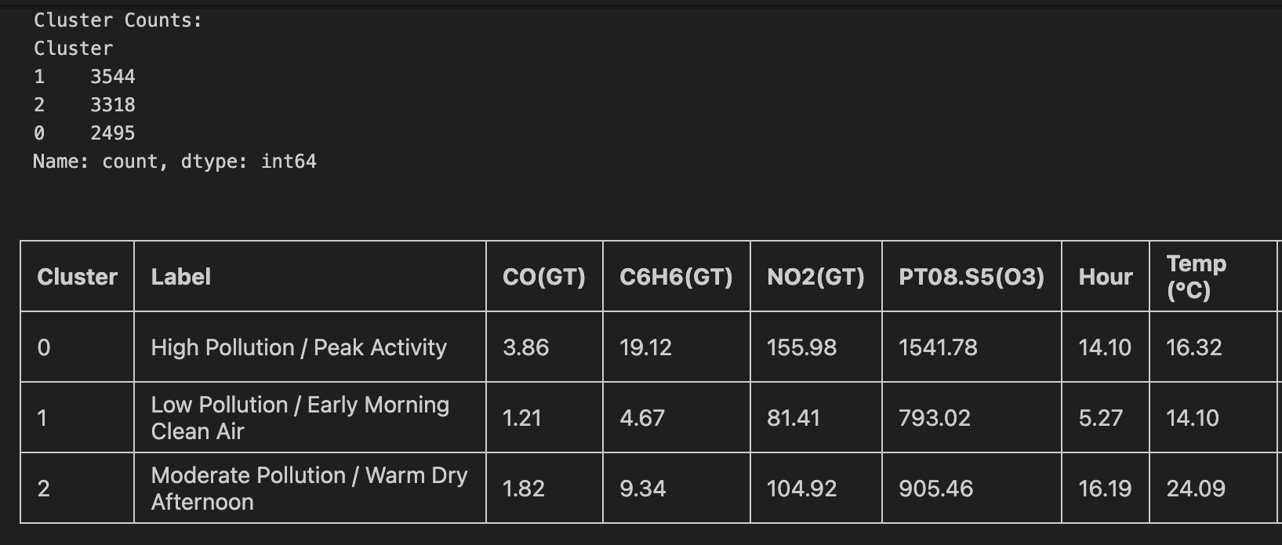
Evaluation
Clustering results
Comparison K-Means vs DBSCAN K-Means: 3 clusters (forced) DBSCAN: 2 clusters + noise
The K-Means clustering method was able to identify three clusters, achieving the initial goal of distinguishing low, moderate, and high pollution density levels
ChatGPT assisted in interpreting the identified clusters
Interpretation of the identified clusters using ChatGPT - K-Means (without predefined pollutant thresholds)

Slide 10
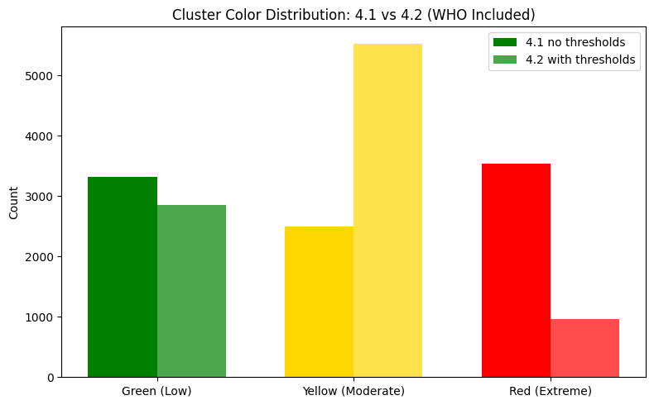
Evaluation
With or Without threshold features?
Incorporating WHO thresholds (4.2 in the graph) made the cluster patterns in the graphs more distinct
Low cluster: 2 out of 4 thresholds were elevated
Moderate cluster: 3 out of 4 thresholds were elevated
High cluster: All thresholds were elevated
Threshold feature produced more Moderate and less High pollution cluster size

Slide 11

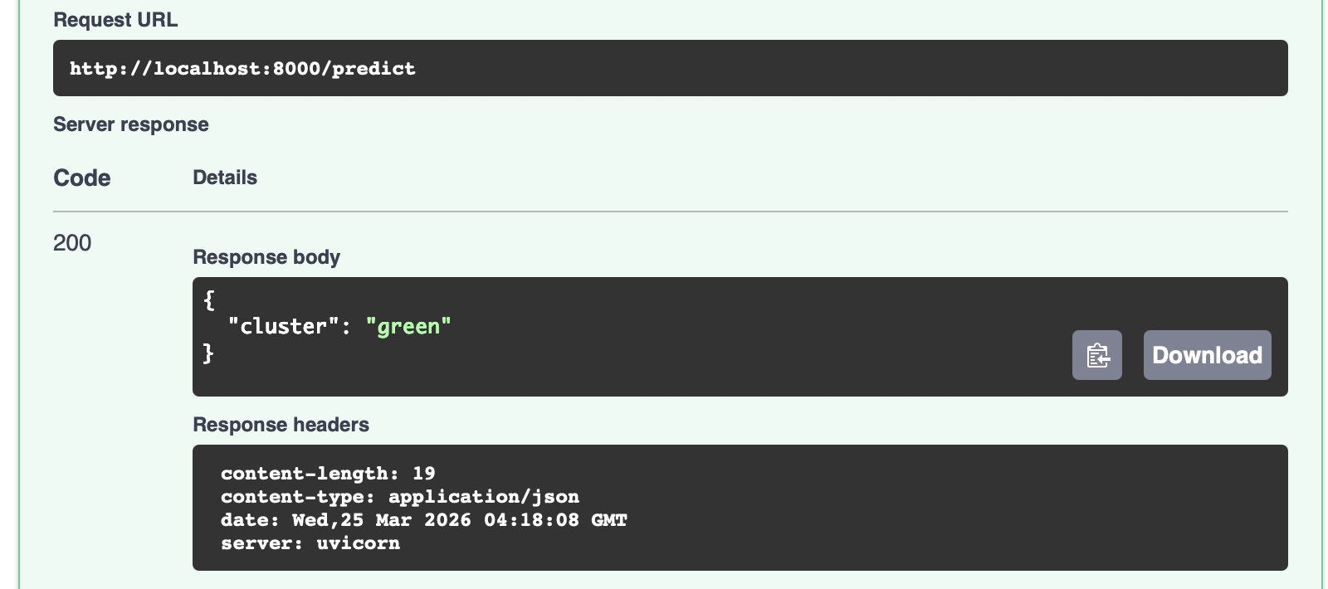
Success?
YES!
It was possible to find 3 clusters mapping them to low, moderate and high pollution levels
Adding thresholds was a good way to challenge and validate the results of the first run on the ‘raw’ data
BUT: Even in the ‘low’ cluster we see 2 of 4 thresholds were met! Indicating that the air quality in this spot is not really good at all
Unfortunately we could hardly see a daily or seasonal effect in the data concerning clustering. “The air is cleaner in the morning” is not really a great insight!
At the moment we just have an API for checking data
The trained model can be used to check other pollutants values (of other locations) and get quickly an answer to the question how ‘good’ the air quality is
In the future it would be great to have a ChatBot that can answer questions about air quality in Italy or other cities in the world!

